Slide 1
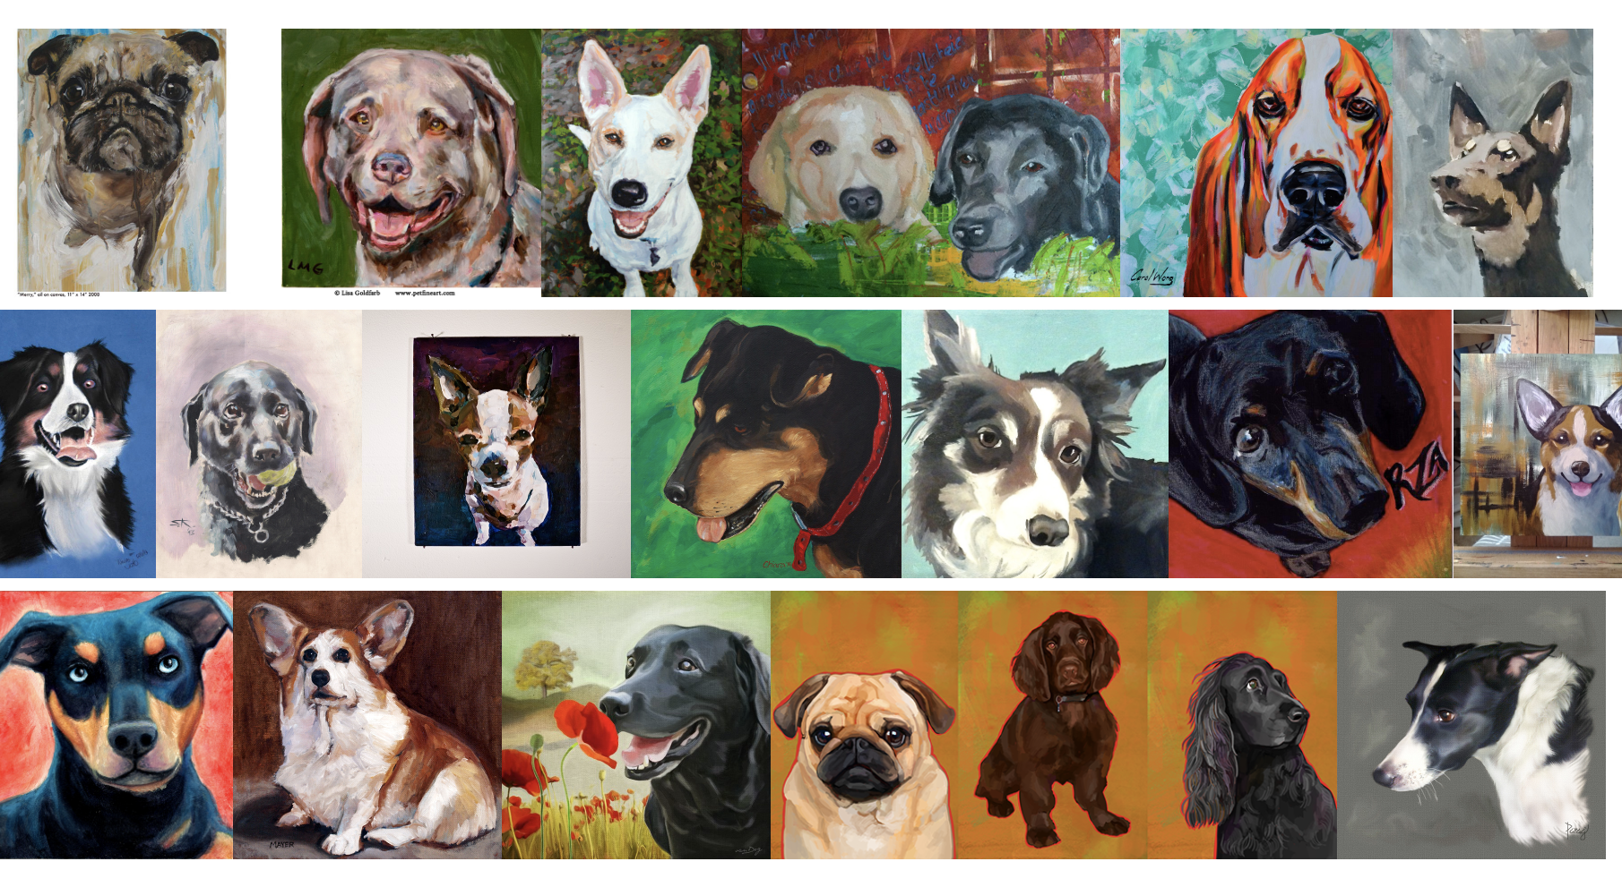
Recommendation System of Images of Art for Users
Timothy Chang
Rhys Chua
Teresa Morales Gomez-Luengo

Slide 2
Agenda
Problem Statement and assumptions
Data Transformation
Data Exploratory Analysis
Models (KNN, Dense Neural Network, CNN )
Results
Future Work

Slide 3
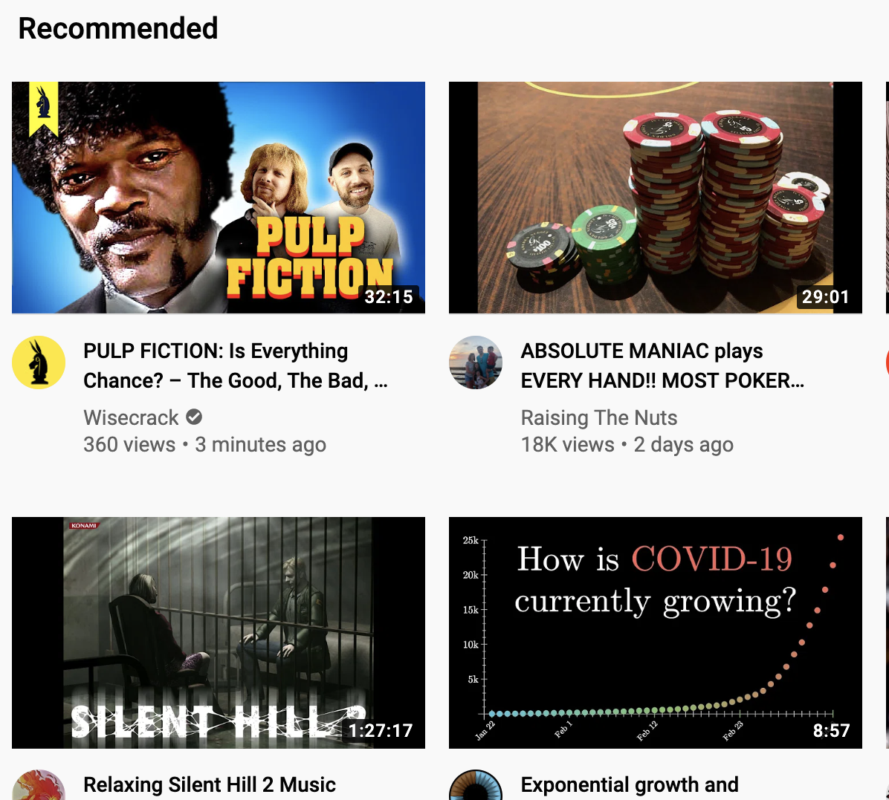
Introduction
Recommender systems are becoming a common staple in business to drive customer engagement and user experience.
2 Main approaches are user-based and item based recommendation.
But what about images, particularly artistic images in social media? How can we use the image itself to predict whether a user will like it or not? What if the data we have is limited?

Slide 4

Problem Statement

Slide 5
Problem Statement and Assumptions
Objective:
Build an item-based recommender system of artwork/art images using pixel data as features and likes as labels
Assumptions:
Training set is representative of all Behance users
Not liking an image and not seeing an image are synonymous
Users’ artwork preferences are constant over time and not influenced by what other users are liking
Notes:
Assumptions:
Probably not true, specially because we have selected a subset of “active” users
Could be improved if we had information on views.

Slide 6
Challenges
1. Detecting users’ preferences of an artwork is more subjective than detecting an object in an image:
Very diverse reasons why a person could like an image
The probability of liking an art piece might change over time, for example depending on your mood or your social and network interactions
2. Data is very large and sparse:
Working with features data from VGG output was computationally intensive
An imbalance data set makes collaborative filtering approach hard to apply
Notes:
individuals do not have time to see all images so the number of likes over total observations is small

Slide 7
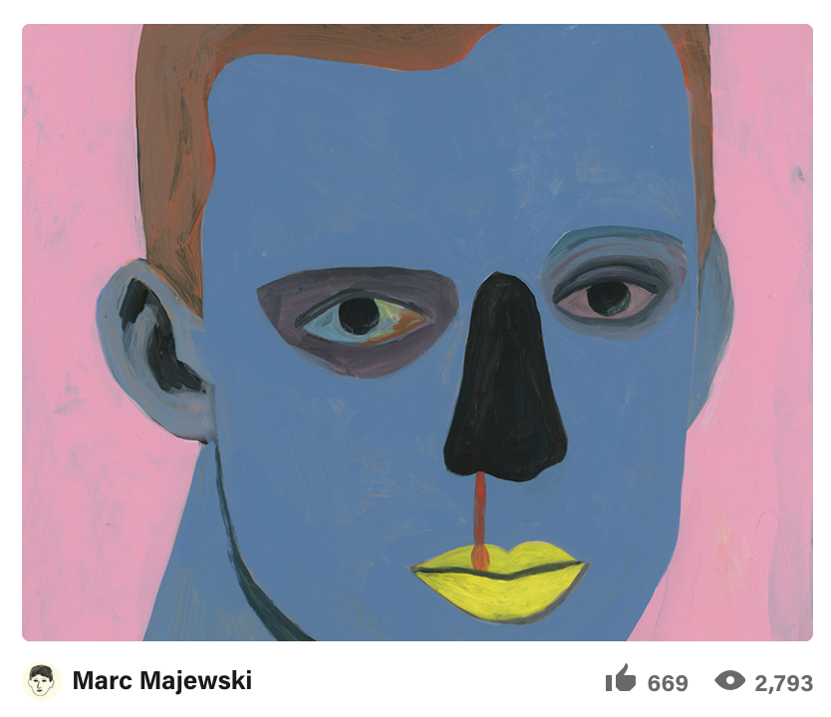
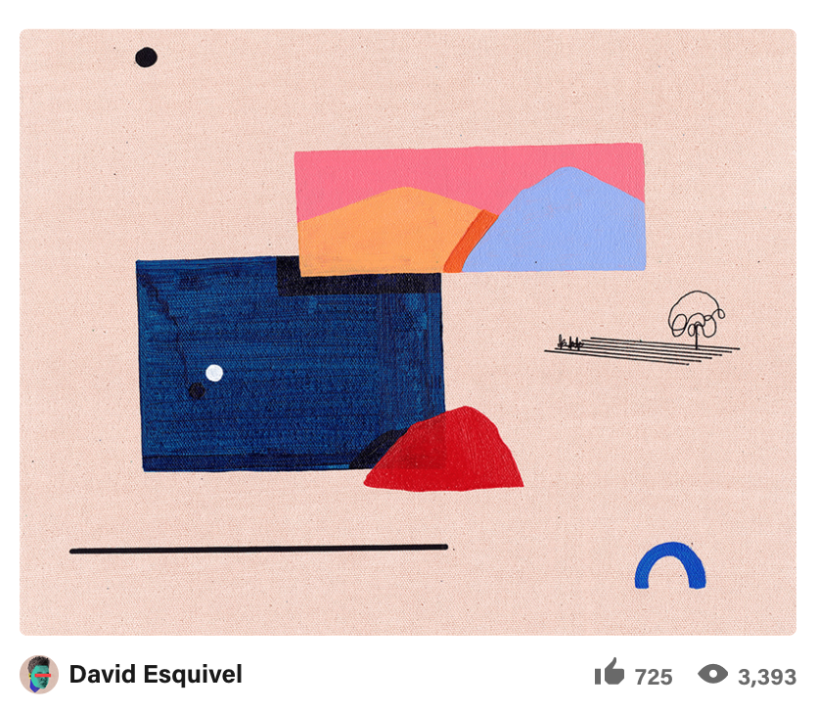
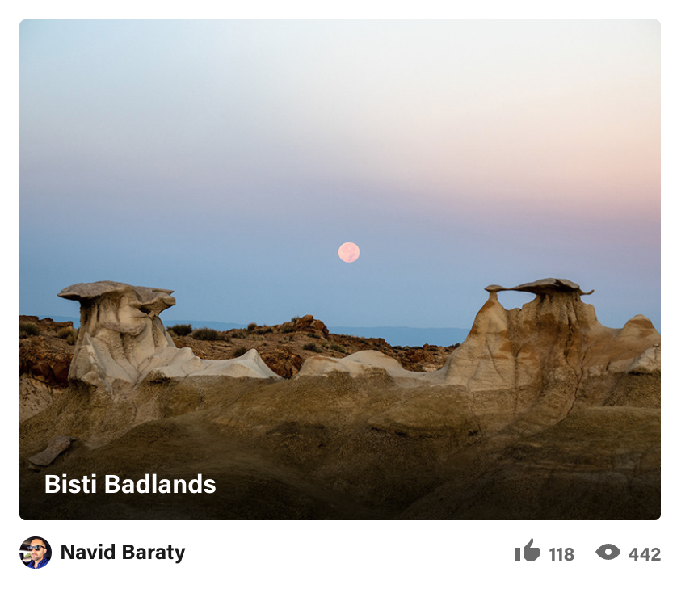
Behance Dataset
Users: 63,497
Items: 178,788 (item id and pixel information)
Appreciates ("likes"): 1M
https://cseweb.ucsd.edu/~jmcauley/datasets.html#behance

Slide 8
Data Properties and Transformations

Slide 9
Data Transformation
Steps:
1- Restructure the data
2- Subset “active” users and “liked” items
→ Due to enormous size of the data, we had to take the steps simultaneously (while reading the data from a generator).

Slide 10
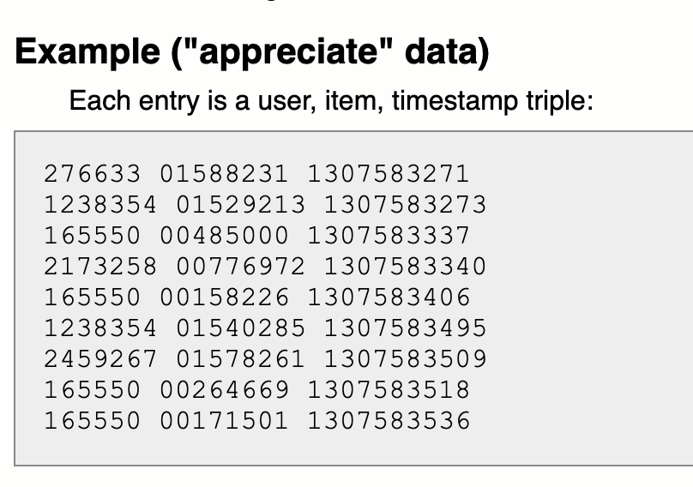
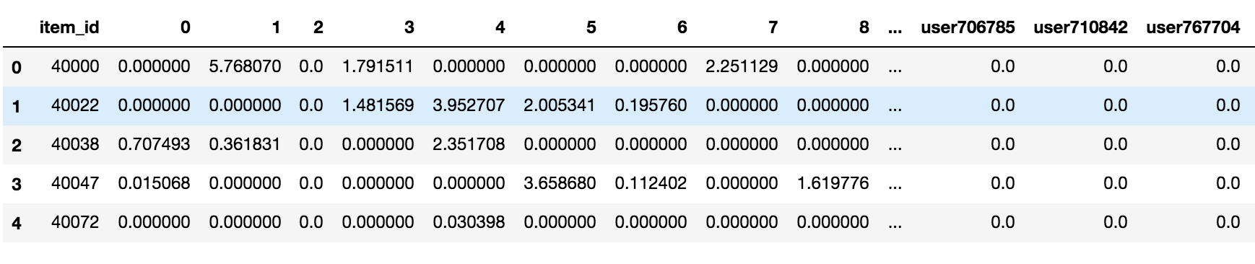
Data Transformation: (1) Restructure data
(1º) We create a sparse matrix (0,1 matrix) where rows are the items and columns are the users. Each 1 represents a “like”. When the user did not like the item OR did not see it, the value is a 0.
user1 user 2 user 3 …..
item 1 0 0 1
item 2 1 0 0
item 3 1 1 0
...
(2º) We merge the features matrix with the likes sparse matrix by item id.
RESULTING DATA FRAME STRUCTURE:

Slide 11
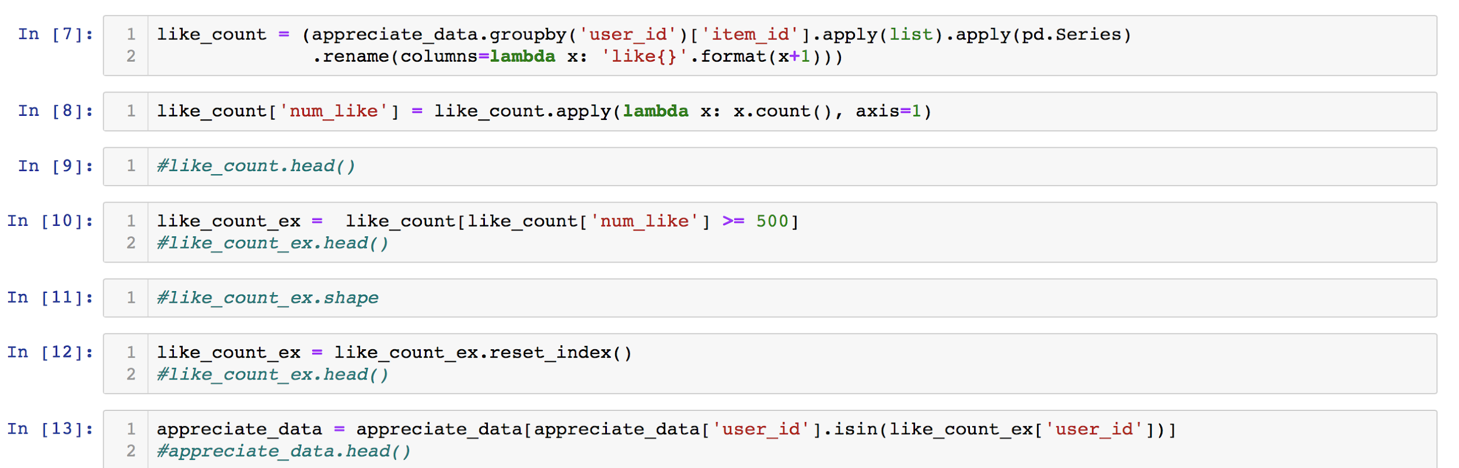
Data Transformation: (2) Subsetting data
The original data set was huge and too sparse.
Over 63,497 users, we selected 132 users that had over 500 likes and items that were liked by at least one of those users.

Slide 12
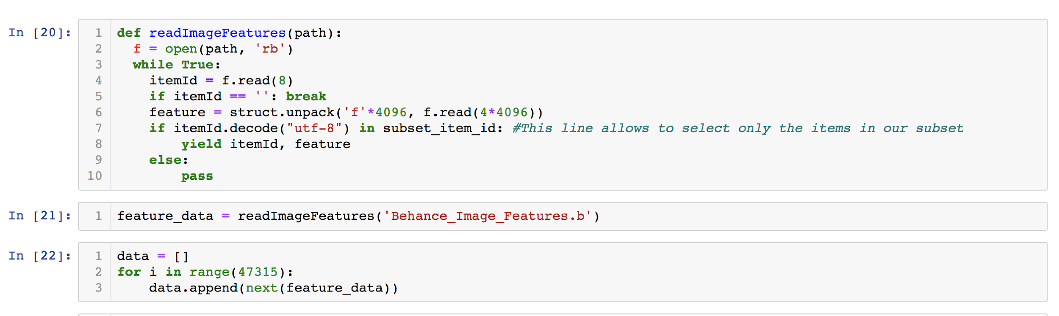
Data Transformation: results
To read the features file for our subset we used the generator provided by the source with the following tweak:
Resulting data frame has 47,315 items, 4096 features and 132 users → X matrix (47,315 x 4,096) Y matrix (47,315 x 132)

Slide 13
Descriptive Statistics
1- Features matrix (X matrix)
2- Likes or labels matrix (Y matrix)

Slide 14
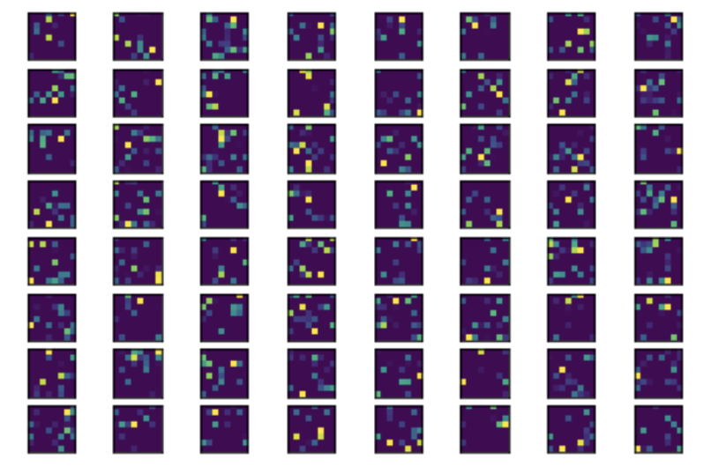
Descriptive Statistics: (1) Features matrix
Features file has 4096 columns (features)
→ Already resulting from a VGG16 neural network
One piece of artwork can be represented as follows:
8x8x64

Slide 15
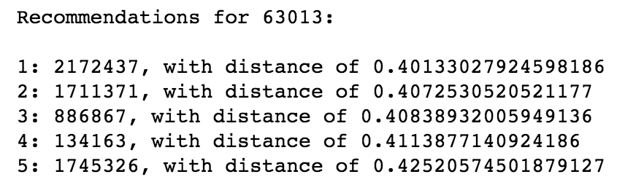
Descriptive Statistics: (1) Features matrix
K means…

Slide 16
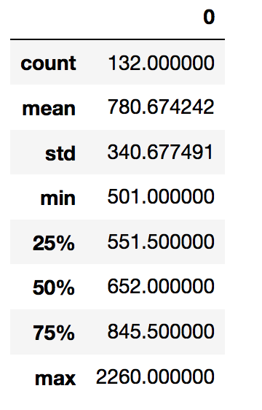
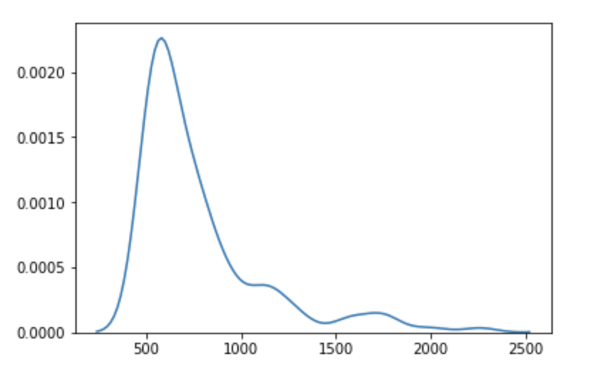
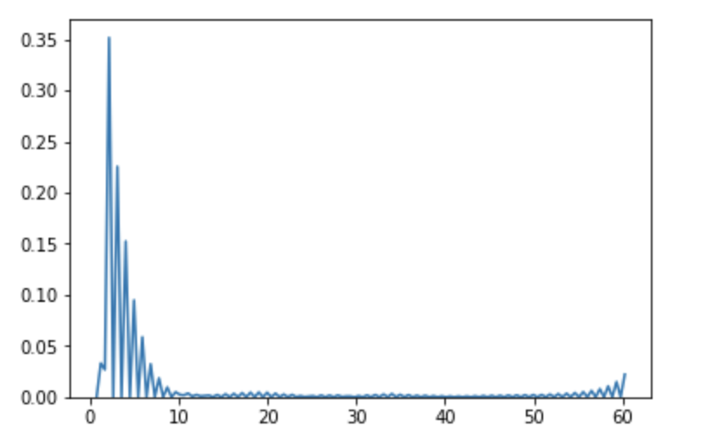
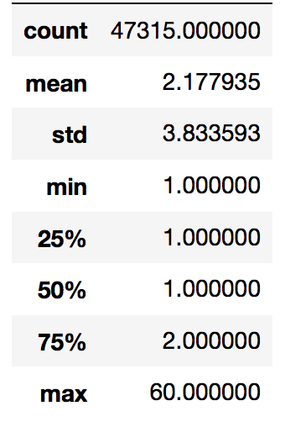
Descriptive Statistics: (2) Labels matrix
Users (columns) :
The mean value of likes per user is 781 with high variation (s.d. of 341). The most active user liked 2,260 images.
Items (rows):
The mean value of likes per item is 2.2 with a sd of 3.8.
As we can see in the distribution most items have between 1 and 10 likes. The highest number of likes for a single item is 60 likes.

Slide 17
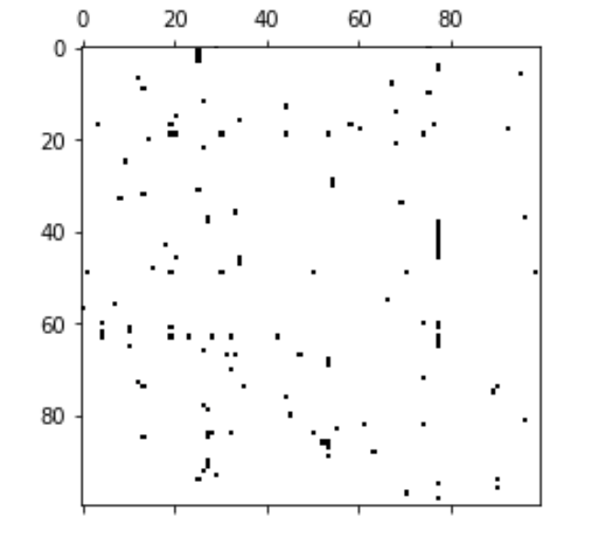
Descriptive Statistics: (2) Labels matrix
A great challenge for our analysis is sparsity:
Labels matrix for a subset of 100 users and 100 items
Out of 6,245,580 potential likes (132 x 47,315), there are only 103,049 likes.
Only 1.65% of the observations are positives

Slide 18
Models

Slide 19
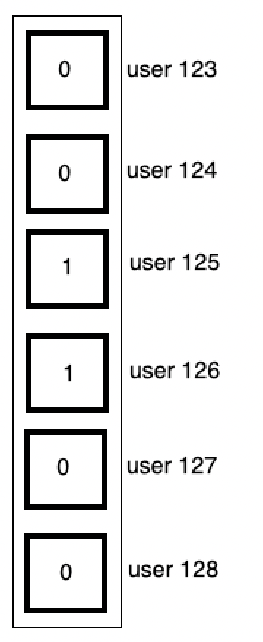
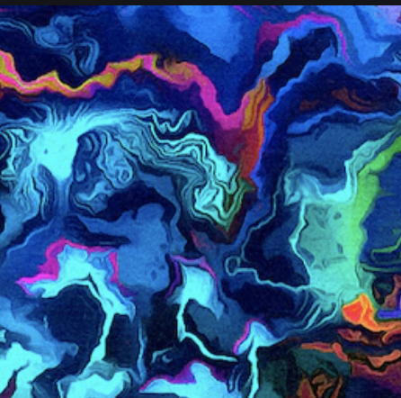

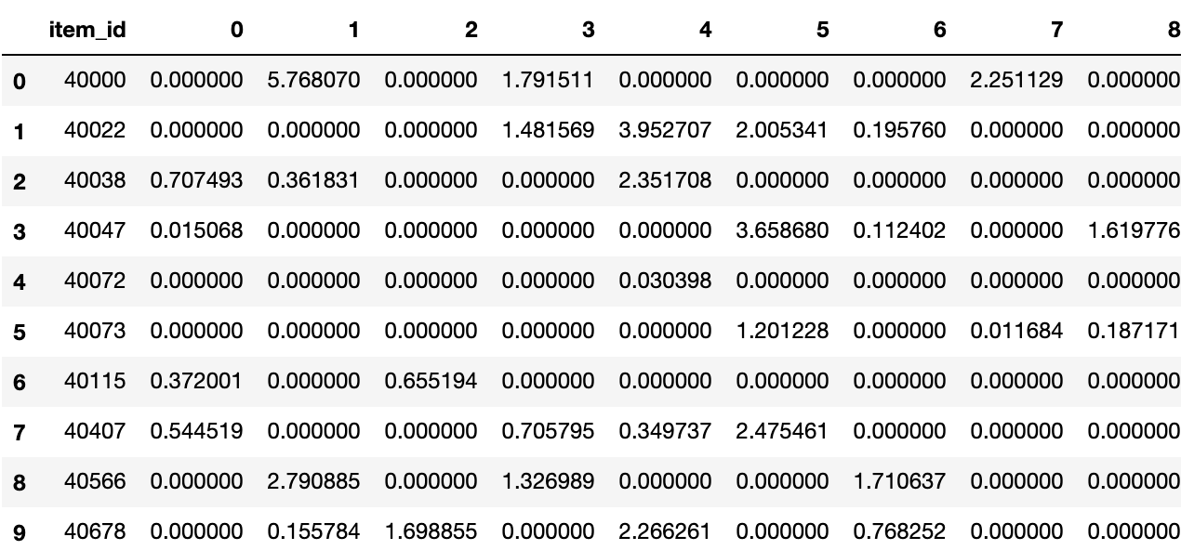
ML Pipeline
Prediction
ML Model
Raw Data
Input

Slide 20
Proposed approaches
Base model: Logistic, using stochastic gradient descent.
Model 1: PCA + KNN (item-based)
Model 2: Dense Neural Network
Model 3: Convolutional Neural Network

Slide 21
Base model
Logistic model, using stochastic gradient descent and MultioutputClassifier:
Hyperparameters:
Learning rate: ‘optimal’ (1.0 / (alpha * (t + t0)) where t0 is chosen by a heuristic proposed by Leon Bottou)
Maximum number of epochs: 1000
Early stopping (stop when loss >best_loss -0.1)

Slide 22
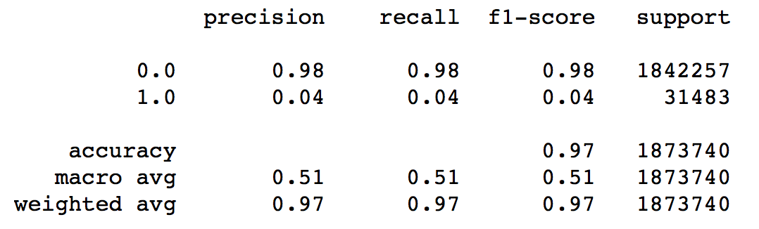
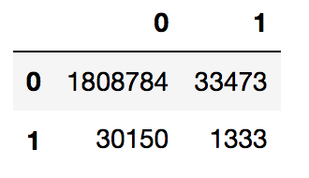
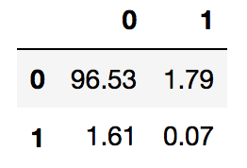
Base model
(2) Results:
The test sample has 1,873,740 potential likes but only 31,483 actual likes (1.7%).
Only 1,333 likes were correctly predicted (0.07% of total observations)
Precision (TP/TP+FP) is 3.83% and recall (TP/TP+FN) is 4.23%.
Recall improves only slightly if we reduce the probability threshold for classifying likes.
Classification report
Confusion Matrix (totals and %)
Labels:
True
Labels:
True

Slide 23

Model 1: PCA + KNN
1- Model structure
2- Training
3- Results

Slide 24
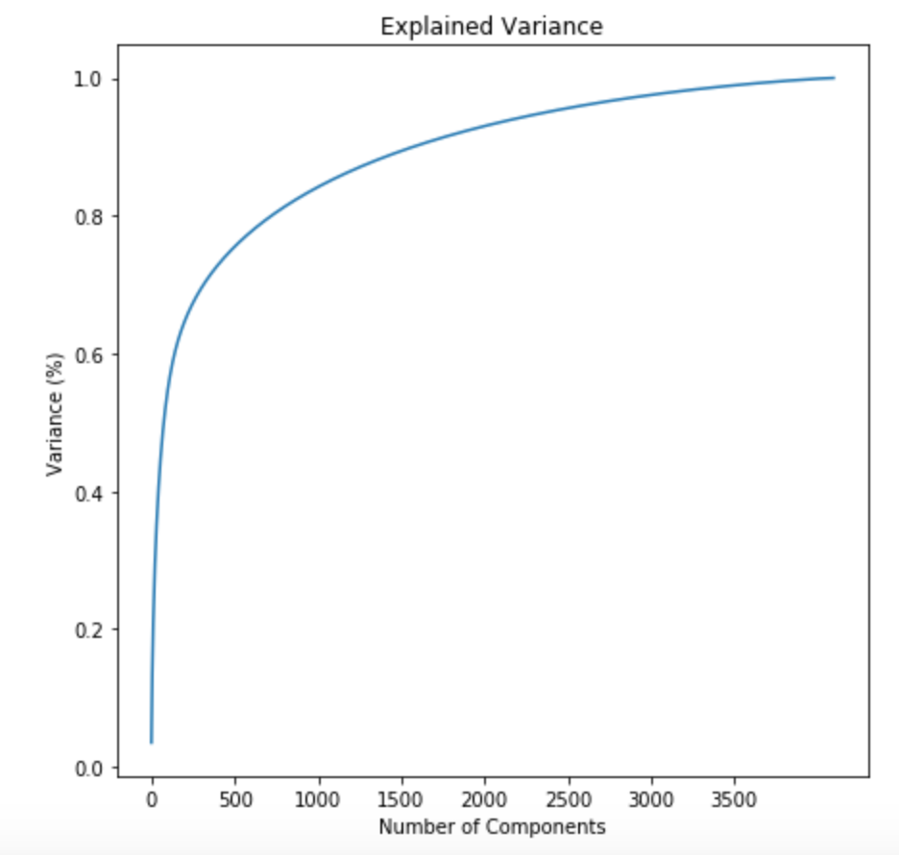
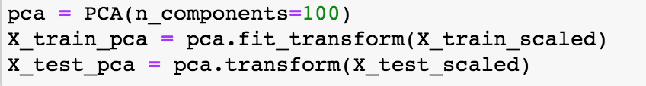
Principal Component Analysis (PCA)
Goal: To reduce feature dimension of the data
Rescale the test data
Look at the cumulative explained variance to see how many components we need
Chose about 100 components

Slide 25
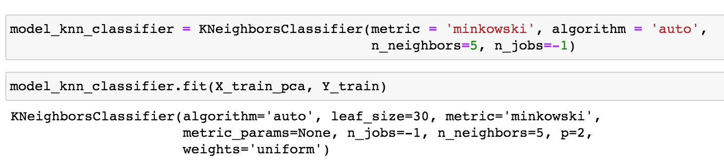
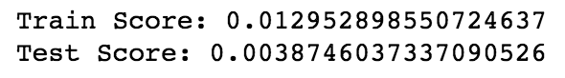
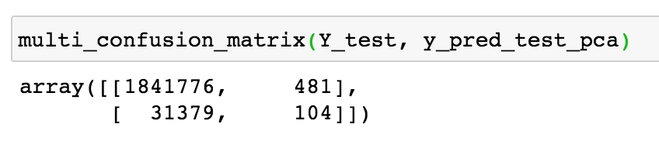
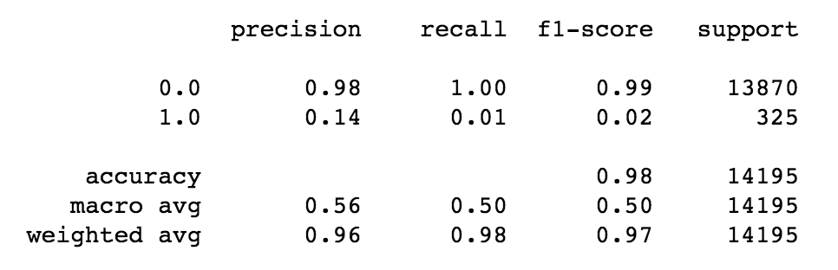
K Nearest Neighbors (KNN)
Goal:

Slide 26
KNN + Random Search Cross Validation

Slide 27

Model 2: Dense Neural Network
1- Model structure
2- Training
3- Results

Slide 28
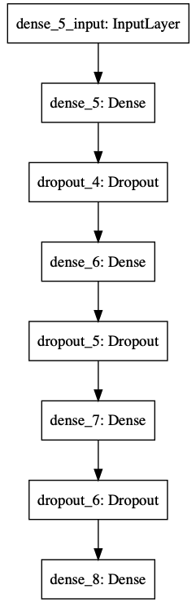
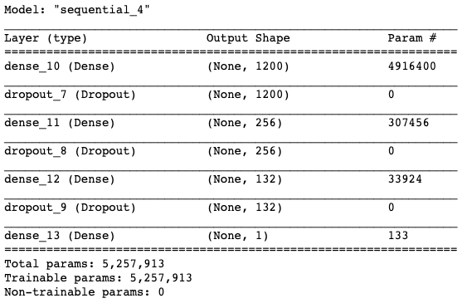
Model 2: Dense. Model structure
Fairly simple Neural Network using only Dense layers and Dropouts to reduce overfitting
Input, 3 Hidden layers, Output
Reduce parameters from 4200 to 132
Relu Activation for all Layers except Output which uses sigmoid activation

Slide 29
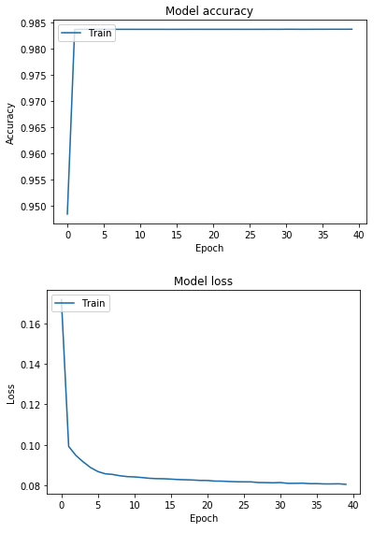
Model 2: Dense. Training
Optimizer: Adam (learning_rate = 0.01)
Loss: Binary cross-entropy
Epochs: 40
Batch_size: 250
Accuracy doesn’t increase after 3 epochs
Loss continues to drop but basically plateaus after 10 epochs
Training takes about 20 minutes

Slide 30
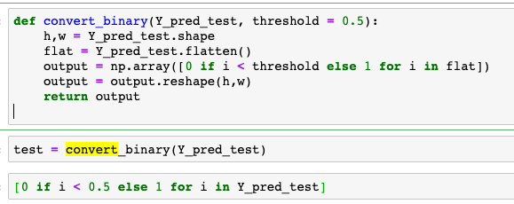
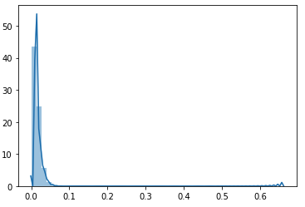
Model 2: Dense. Results
Convert to 0/1
Neural Network output is not binary values, they return a float between 0 and 1
Model lowered threshold drastically to the point we had to change the threshold to get any positive predictions
Some tweaking of the threshold resulted in 45k likes out of 1.8 million
Probability Threshold

Slide 31
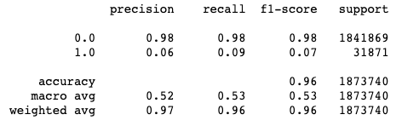
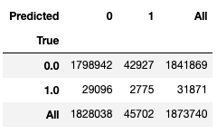
Model 2: Dense. Results
Recall of about 9% with Recall of 6%
Weighted accuracy not much better than base but precision is considerably better
Out of 20 suggestions, User will like 1
However, we must consider that the image we suggest shares characteristics that they may like when suggested
Classification report
Confusion Matrix (totals)

Slide 32

Model 3: Convolutional Neural Network
1- Model structure
2- Training
3- Results

Slide 33
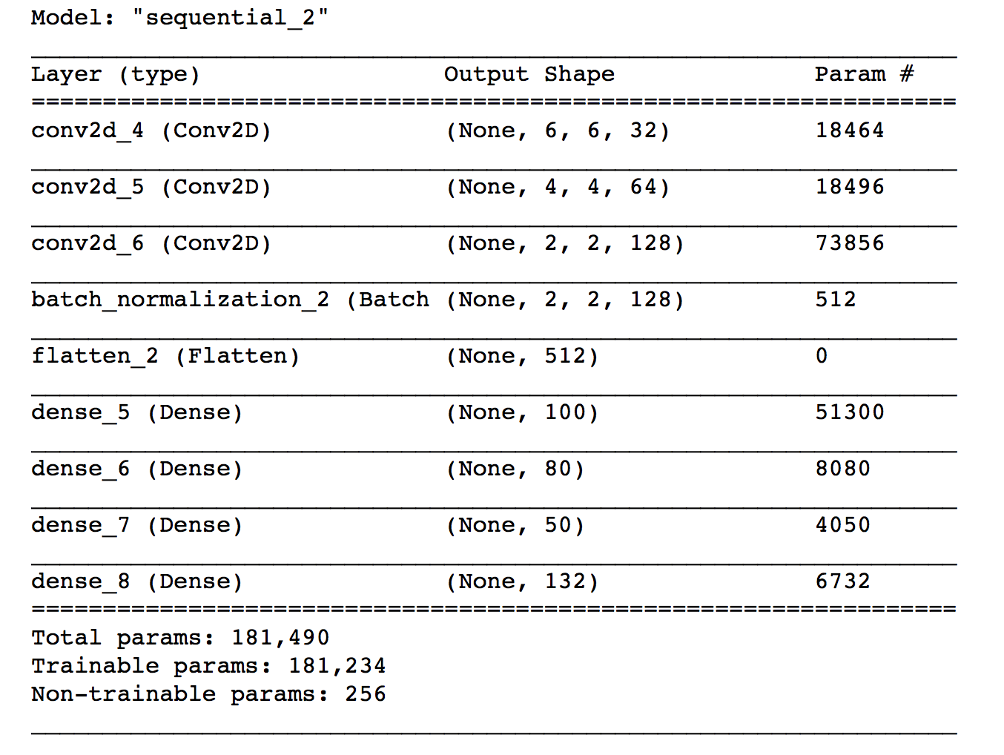
Model 3: CNN. Model structure
3 CNNs (2-dimensional)- relu
→ Version B: includes regularization parameters
Batch normalization (Only Version B)
Flatten layer
Dense hidden layers - relu
Final sigmoid activation function

Slide 34
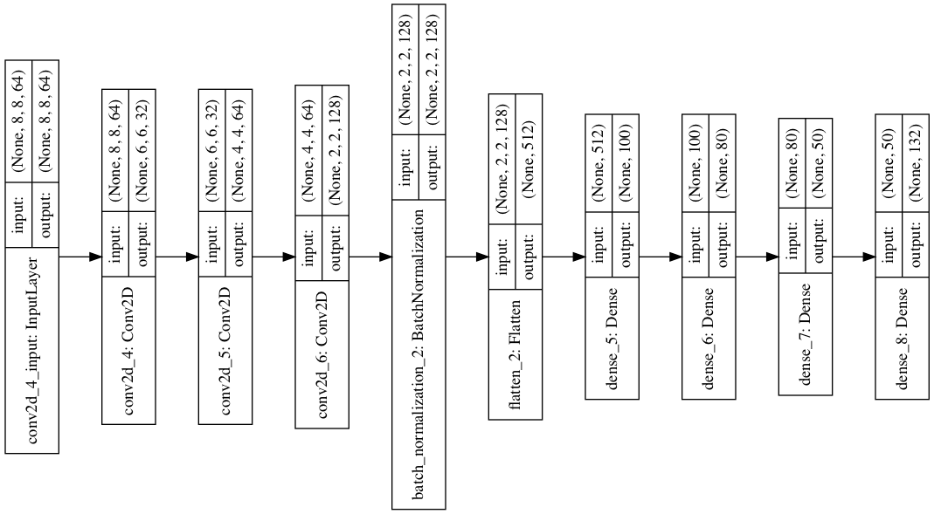
Model 3: CNN. Model structure

Slide 35
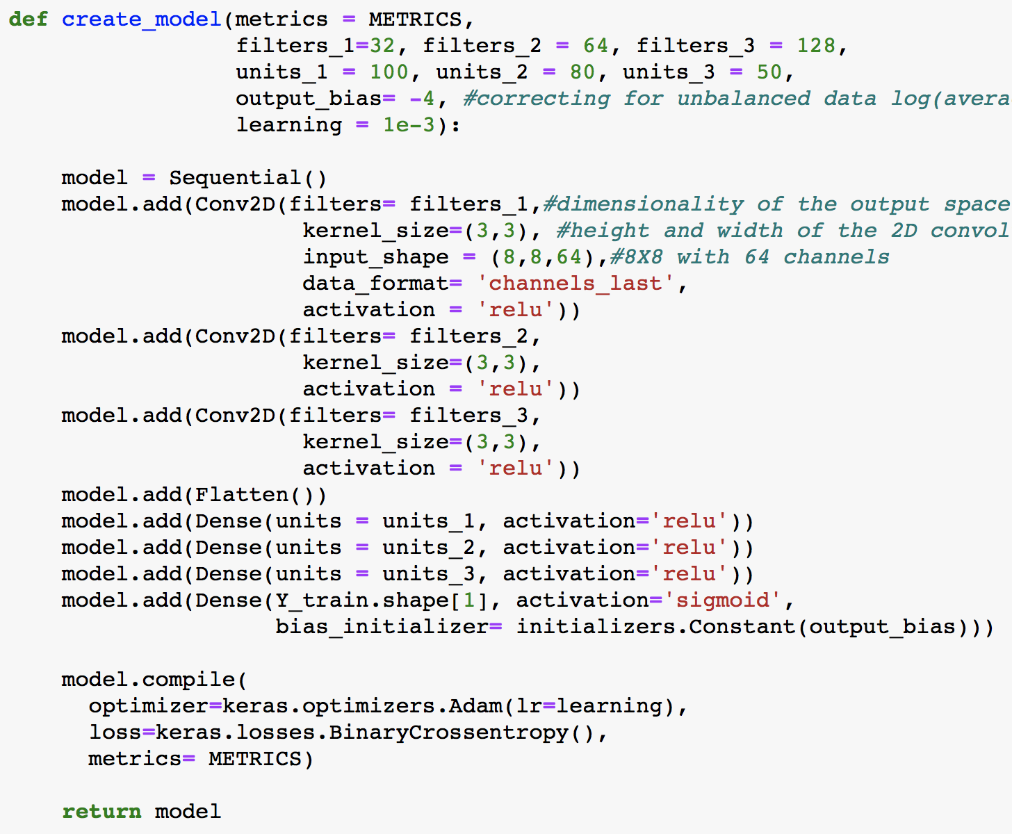
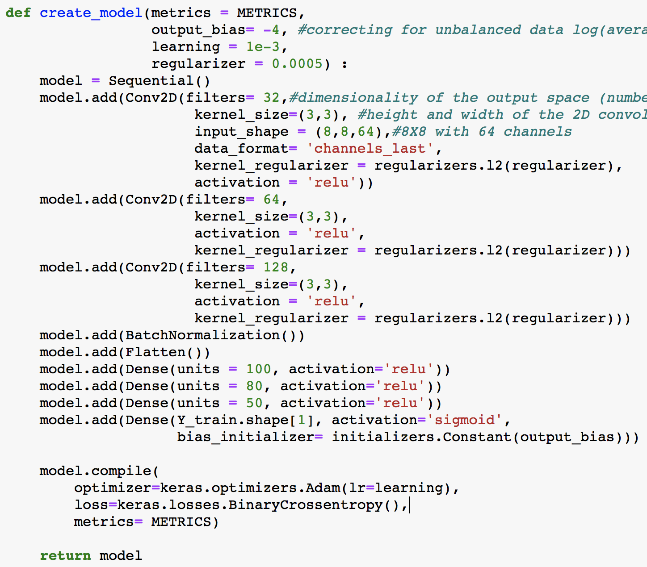
Model 3: CNN. Model structure
Version A: No regularization
Version B: Including regularization and Batch normalization

Slide 36
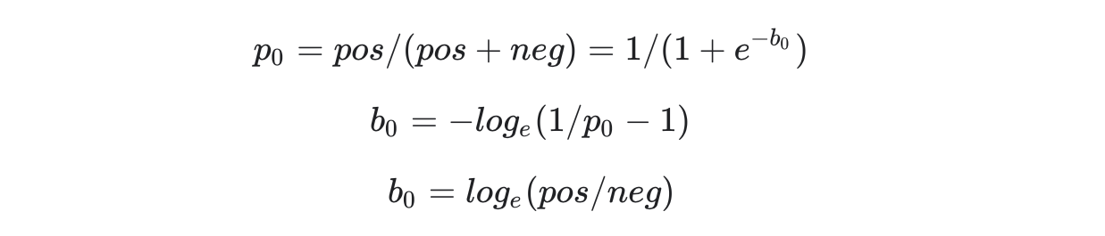
Model 3: CNN. Training
In order to deal with imbalanced data we do the following:
Set the initial output layer’s bias at -4, given the following formula for the average user:
https://www.tensorflow.org/tutorials/structured_data/imbalanced_data
Set weights at 1:60 during training

Slide 37
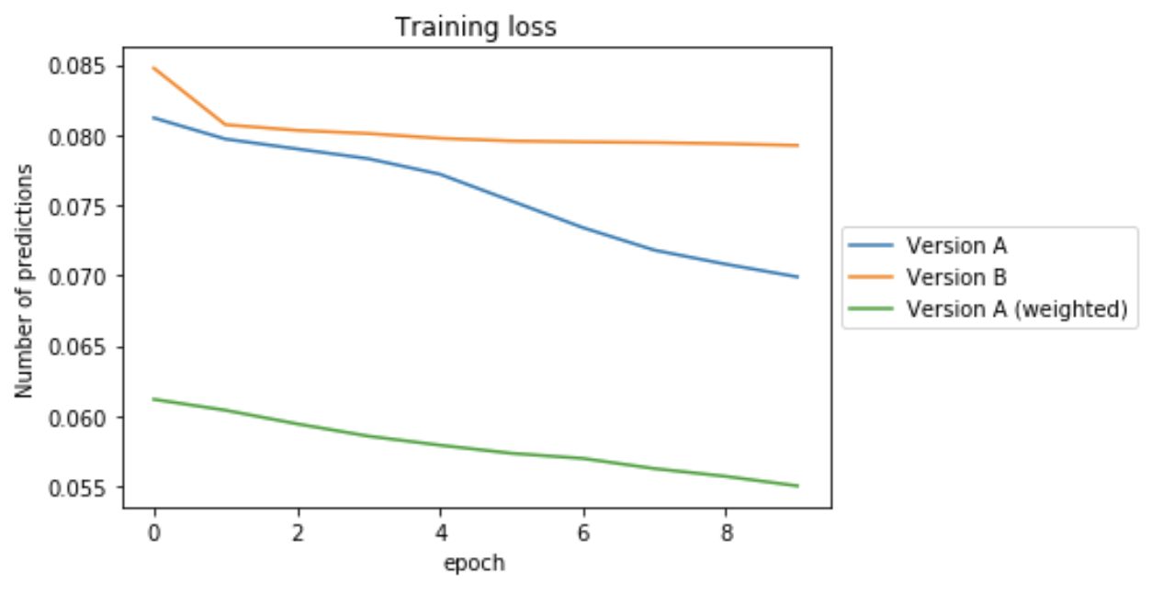
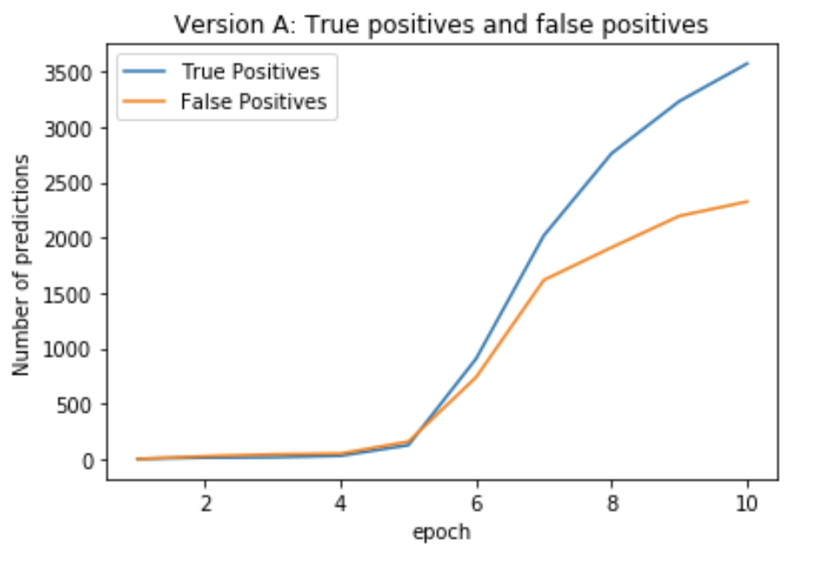
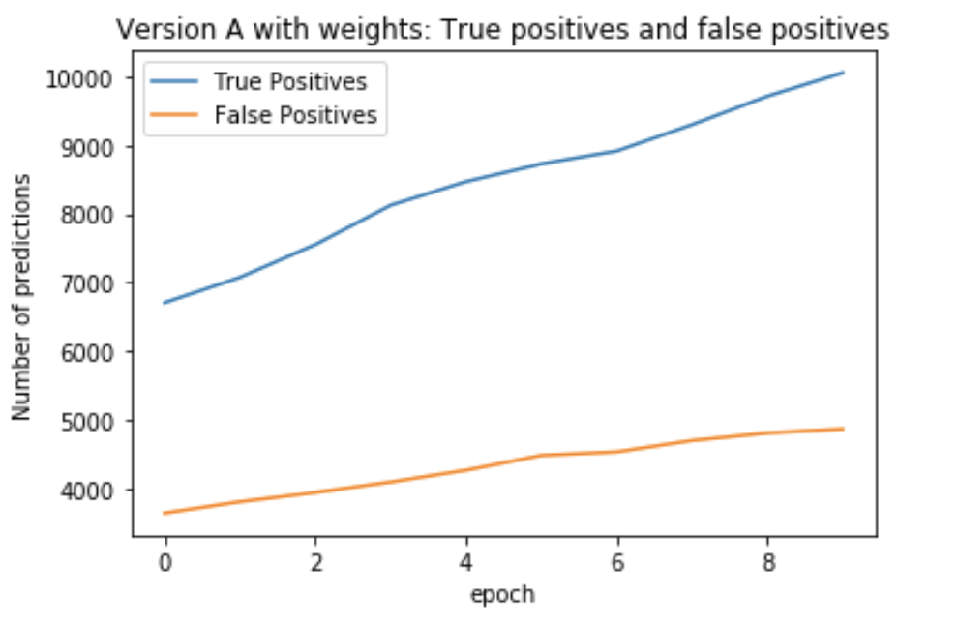
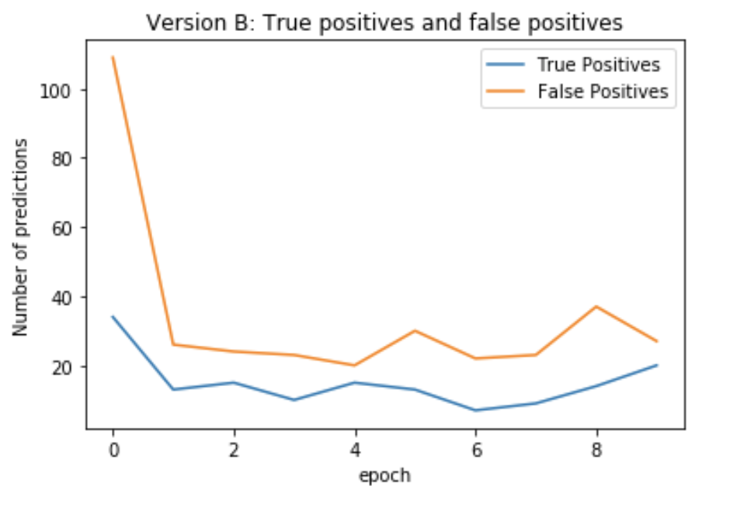
Model 3: CNN. Training
→ For both versions we used:
Binary Crossentropy
Adam optimizer
10 epochs
Batch size of 40
→ But important differences...

Slide 38
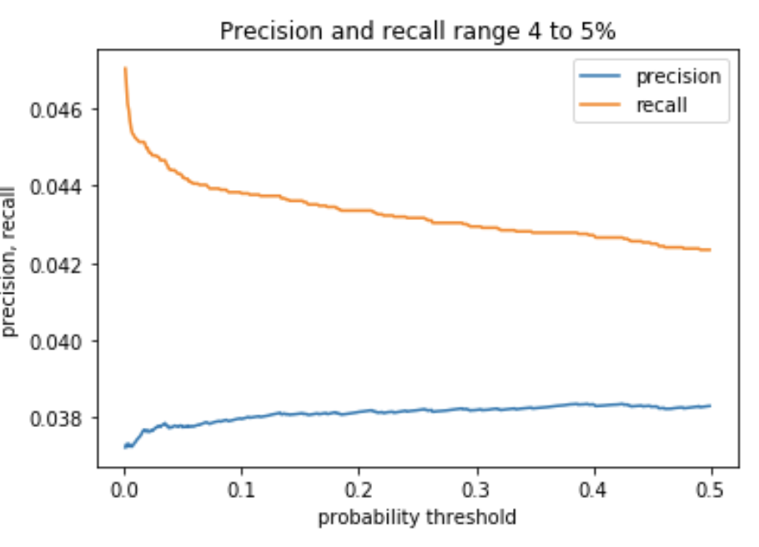
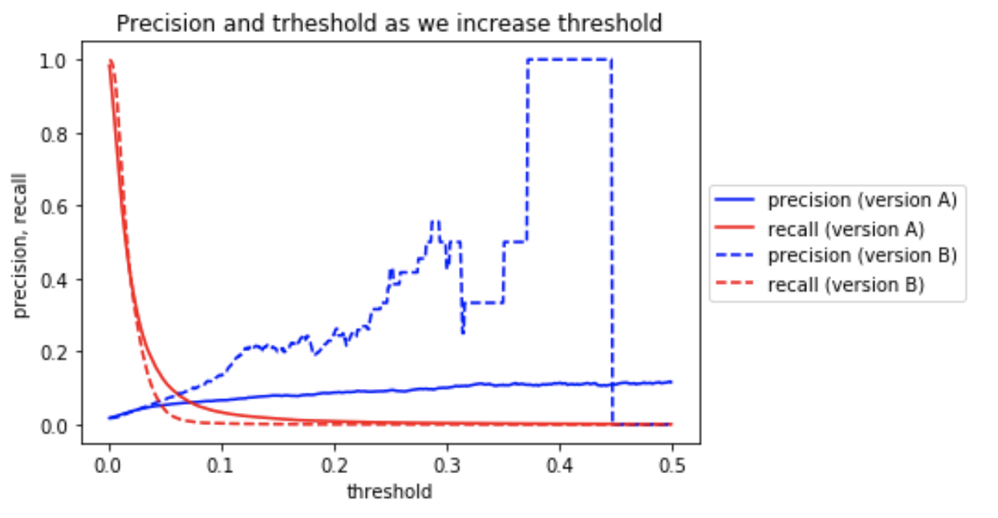
Model 3: CNN. Results
Base model (logistic)
CNN(versions A and B)
CNN yields higher precision and recall
...A or B?

Slide 39
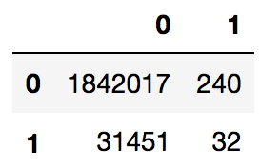
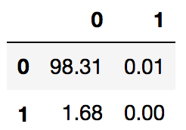
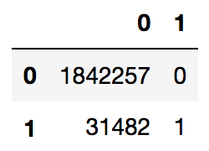
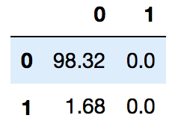
Model 3: CNN. Results.
Maximizing precision results in very few true positives (only 32 correctly predicted likes for version A and 1 for version B).
Confusion matrix Version A (total and %) Confusion matrix Version b
We consider it is better to lower the sigmoid threshold and concentrate on recall.

Slide 40



Model 3: CNN. Results. Version A
For version A, lowering it to 0.019 we set recall at around 40% and get:
Classification report Confusion matrix (total and %)
djw
We have a high rate of false positives, but considering assumptions and business application, this should not be a huge problem.
Precision rate similar to base model but 10 times more correctly predicted likes (13,180 vs 1333)

Slide 41



Model 3: CNN. Results. Version B
For version B, lowering it to 0.019 we also set recall at around 40%:
Classification report Confusion matrix (total and %)
Slightly higher!
Choosing version A or B depends
on which recall rate we would want
(our tolerance to false positives)

Slide 42
Results and Future Work

Slide 43

Model Comparison
Logistic Regression
KNN
Dense Neural Network
Convolutional Neural Network
Logistic Regression – Recall:0.04 Precision:0.04
K Nearest Neighbors – Recall: 0.01 .Precision: 0.14
Dense NN – Recall: 0.09 Precision:0.06
CNN – Recall: 0.42 Precision: 0.04

Slide 44





Findings
No model is perfect, we must sacrifice precision to increase recall and vice versa.
Overall CNN Model is most viable with high recall and reasonable precision
Even if test data says our predication is wrong, there is a chance that model will recommend images that share similar features
Users will only need to like 5-10% of the recommended items to be considered helpful
As predicted, our limited data and nuanced behavior of users makes a precise model very difficult

Slide 45
Future work
Use additional information:
→ Timestamp, connexions between content creators, views ...
Continuous Tweaking of Algorithms
Combine feature based approach with collaborative filtering
A/B Testing on Users
Active learning to deal with unbalanced data
Bucket Users into Clusters
Use SMOTE to handle imbalance data to increase F1 and recall score

Slide 46
Future Work
Use additional information: (timestamp, connections between content creators, views ...)
Continuous Tweaking of Algorithms
Combine feature based approach with collaborative filtering
A/B Testing on Users
Active learning to deal with unbalanced data
Bucket Users into Clusters
Use SMOTE to handle imbalance data to increase F1 and recall score

Slide 47
Thank you!

